Slide 1

End-to-End VM Connectivity Across Subnets Using sshuttle, WireGuard, and Static Routing
Presented by Visesh Bentula
Notes:
1.7.2013
‹#›

Slide 2
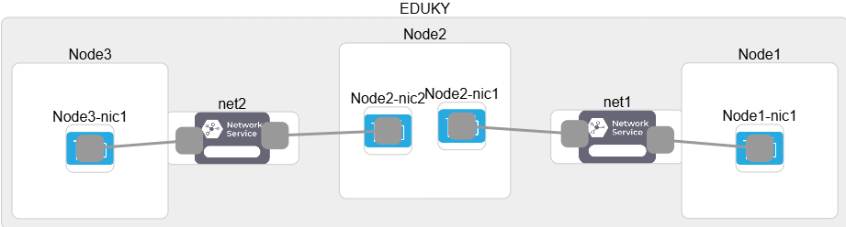
Network topology (FABRIC)
This is the network slice I created on FABRIC. Node1 and Node3 are on two separate subnets, and Node2 sits in the middle with two network interfaces. Node2 acts like a router or bridge, and I tested three methods sshuttle, WireGuard, and static routing to achieve end-to-end connectivity between Node1 and Node3
Notes:
1.7.2013
‹#›

Slide 3
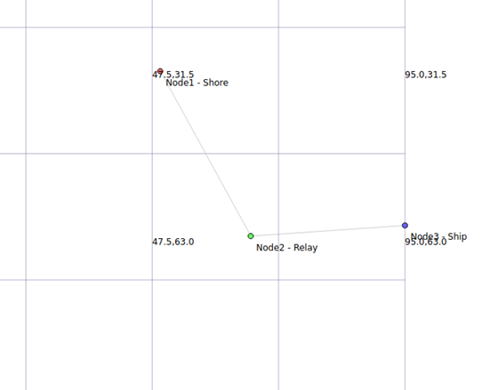
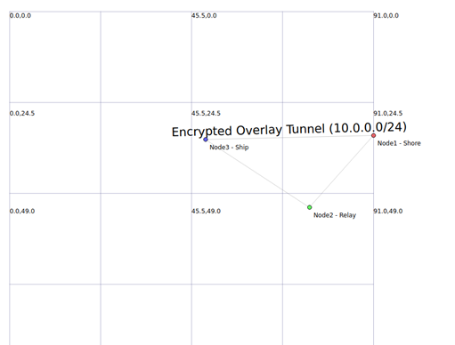
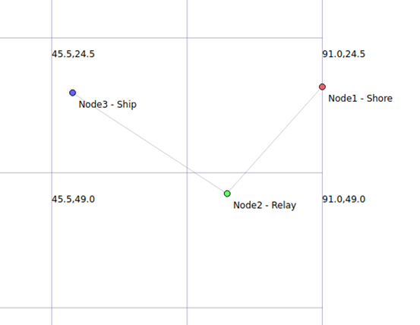
Network topology from NetAnim (NS3)
sshuttle
Wireguard
static
This ns-3 topology replicates the architecture from the FABRIC testbed with three nodes Node1 (Shore), Node2 (Relay), and Node3 (Ship) connected via two point-to-point links. Node2 serves as a router bridging two subnets. Three methods were tested for end-to-end connectivity between Node1 and Node3: Static Routing, WireGuard-style overlay, and sshuttle-style TCP relay, enabling comparison of throughput, delay, and packet loss across different routing and tunneling setups.
Notes:
1.7.2013
‹#›

Slide 4
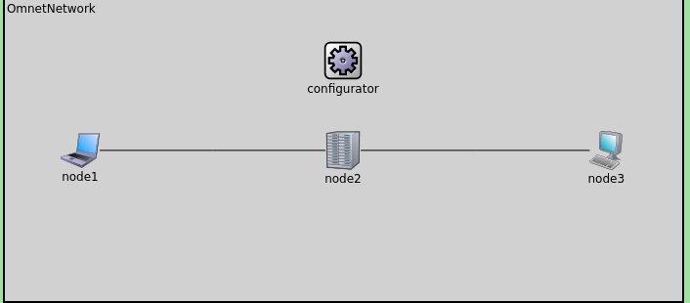
Network topology (Omnet++)
This topology was simulated in OMNeT++ using the same three-node structure across all modes. Node1 (Shore) and Node3 (Ship) are on separate subnets, while Node2 (Relay) sits in between with two interfaces acting as a router or forwarding bridge. Using the same physical layout, three approaches Static Routing, WireGuard-style overlay, and sshuttle-style TCP relay were configured to establish end-to-end communication between Node1 and Node3. Each mode was implemented through different application and routing configurations to evaluate how tunneling and forwarding methods affect overall network performance.
Notes:
1.7.2013
‹#›

Slide 5

What is sshuttle?
sshuttle is a user-space VPN-like tool that forwards TCP traffic over an existing SSH connection.
It works by intercepting traffic on one node and tunneling it transparently through another node.
Advantages: quick setup, no need for root-level routing changes, useful for debugging or bypassing firewall restrictions.
Limitation: only supports TCP traffic; does not handle UDP or ICMP packets (e.g., ping).
Conceptually, sshuttle is a lightweight alternative to static routing or VPNs.
01
Notes:
1.7.2013
sshuttle forwards traffic from your computer through an SSH tunnel to another computer.
Unlike a normal SSH tunnel where you forward only one port, sshuttle can forward an entire subnet of traffic.
This makes it feel like you’re on the remote network, without needing special VPN software.
“sshuttle is like a quick, lightweight VPN built on top of SSH. It captures TCP traffic and forwards it through an SSH tunnel. The big advantage is that it’s very easy to set up and doesn’t require complex configuration. It’s useful for debugging or when we want temporary connectivity, especially in firewalled environments. The downside is that sshuttle only supports TCP traffic — so things like pings or UDP traffic won’t work. Conceptually, you can think of sshuttle as a lightweight shortcut between nodes.”
‹#›

Slide 6

What is WireGuard?
WireGuard is a modern, high-performance VPN protocol designed to be simple yet highly secure.
It creates an encrypted point-to-point tunnel using a small set of cryptographic primitives.
Advantages:
Strong encryption with minimal overhead
Supports all traffic types (TCP, UDP, ICMP)
Faster and easier to configure compared to traditional VPNs
WireGuard is widely used in production networks and is well-suited for research testbeds like FABRIC.
02
Notes:
1.7.2013
“WireGuard is a modern VPN protocol that’s designed to be simple, secure, and very fast. It creates an encrypted tunnel between machines, so everything sent across it is protected.
Unlike sshuttle, WireGuard supports all types of traffic: TCP, UDP, and ICMP. It’s easy to configure and has less overhead compared to older VPNs. Because of this, it’s often used in real-world production networks as well as in research environments like FABRIC. In short, WireGuard is ideal when we want long-term, secure, and flexible communication.”
‹#›

Slide 7
What is Static Routing?
Static routing is the manual configuration of network paths using commands like ip route.
Each node is explicitly told which gateway to use to reach another subnet.
Advantages: full control, transparency, works for all protocols without tunneling overhead.
Limitations:
Not encrypted (unlike WireGuard)
Inflexible, any change in the network requires manual updates.
Conceptually, static routing is like a hard-coded map that ensures traffic flows in a predictable way
03
Notes:
1.7.2013
Static routing is the manual way of telling computers how to reach each other. Instead of relying on automatic routing, we explicitly define the path using commands like ip route.
The main advantage is that we get full control and transparency — we know exactly where the traffic is going. It also supports all types of protocols without needing tunneling.
However, static routing is not encrypted, and it’s less flexible. If the network changes, we have to manually update the routes. Conceptually, static routing is like a hard-coded map of the network.”
‹#›

Slide 8
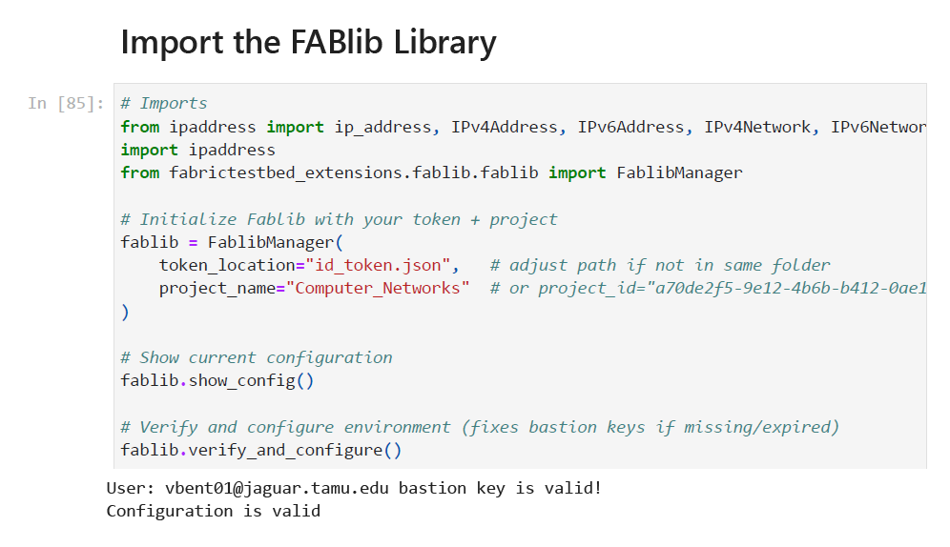
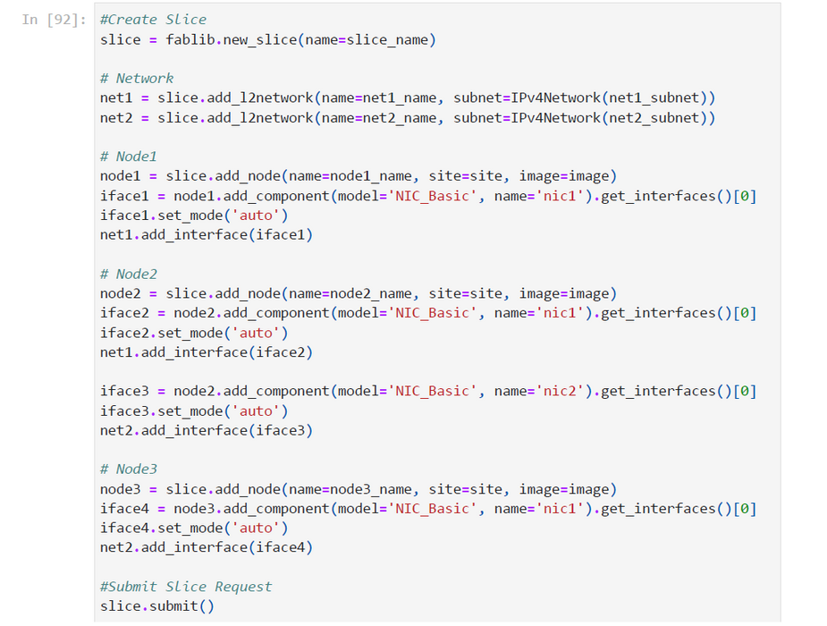
04
FABRIC Setup (Token & Slice Creation)
Token = authentication key, Slice = mini network lab
01
02
After completing the setup, I proceeded by following the research methodology and step-by-step process outlined in the project artifacts
Thynk Unlimited
-
Project
-
Presentation 2024
Notes:
1.7.2013
This slide shows the two main steps to set up our FABRIC environment. On the left, we import and configure the FABlib library using a token and project ID — basically our login key and project name. We also verify that the environment is ready. On the right, we create a slice, which is like our own private mini-lab inside FABRIC. We define networks, add three nodes, connect them, and then submit the slice request. Once that’s done, FABRIC gives us a set of machines that we can use for testing sshuttle, WireGuard, and static routing.
‹#›

Slide 9
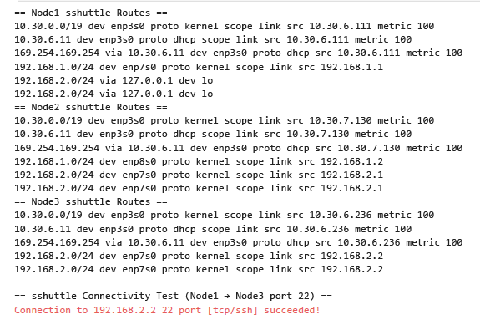

Fabric (sshuttle Results)
What Worked:
sshuttle created an SSH-based tunnel through Node2
A dummy route allowed Node1 to reach Node3’s subnet
Node1 successfully connected to Node3 (TCP port 22)
Routing table showed traffic for 192.168.2.0/24 redirected via 127.0.0.1
What Failed / Limitation
sshuttle only supports TCP traffic
Does not handle ICMP (ping) or UDP
Conclusion:
sshuttle provided quick TCP connectivity with minimal setup
Best suited for debugging or temporary access, not full connectivity
05
Notes:
1.7.2013
“With sshuttle, we created an SSH-based tunnel through Node2. A dummy route allowed Node1 to reach Node3’s subnet. Node1 successfully connected to Node3 using TCP, and the routing table confirmed traffic redirection.
However, sshuttle only supports TCP, so pings and UDP traffic don’t work.
In conclusion, sshuttle is best for quick connectivity or debugging but not for full-scale networking.”
‹#›

Slide 10
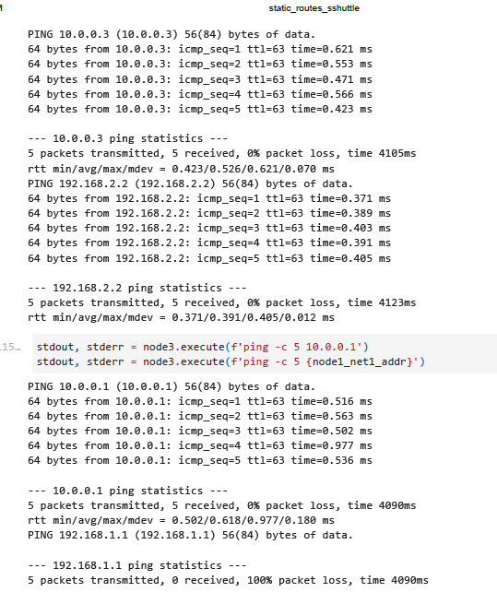

Fabric (WireGuard Results)
What Worked:
Node1 ↔ Node3 tunnel communication (10.0.0.x) successful
Node1 reached Node3’s underlay (192.168.2.2)
TCP test confirmed SSH connectivity on port 22
What Failed (100% Packet Loss):
Node3 could not ping Node1’s underlay (192.168.1.1)
Cause: WireGuard only forwards traffic defined in AllowedIPs
Node2 lacked forwarding/NAT rules to bridge overlay → underlay
Conclusion:
The packet loss is expected, not an error in WireGuard
To fix: enable forwarding/NAT on Node2 to allow overlay traffic to reach underlay IPs
06
Notes:
1.7.2013
“WireGuard was installed and configured on all three nodes, creating an overlay network in the 10.0.0.x range.
Node1 and Node3 communicated successfully over the tunnel, and Node1 reached Node3’s underlay IP. A TCP test confirmed SSH access as well.
However, Node3 could not ping Node1’s underlay address, showing 100% packet loss. This was expected, because WireGuard only forwards traffic defined in the AllowedIPs setting, and Node2 wasn’t configured with NAT or forwarding rules.
So the packet loss isn’t an error — it simply shows that the tunnel was isolated from the underlay network. Overall, WireGuard provided full end-to-end encrypted connectivity and is very reliable.”
‹#›

Slide 11
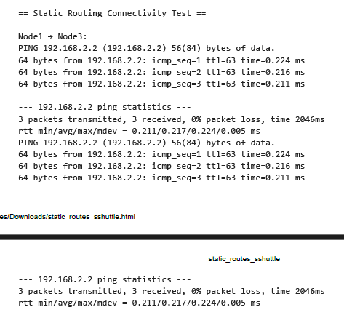
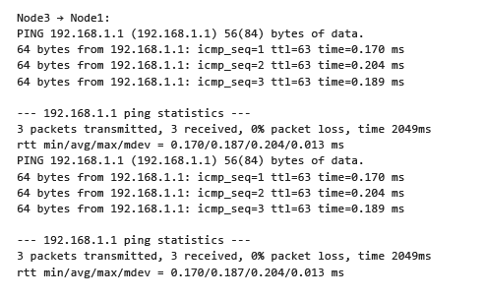
Fabric (Static Results)
What Worked
WireGuard and sshuttle were stopped to avoid interference
Node2 was configured with IP forwarding, acting as a router
Static routes set via Node2’s interfaces:
Node1 → Node3 via 192.168.1.2 (Node2)
Node3 → Node1 via 192.168.2.1 (Node2)
Ping confirmed connectivity between Node1 (192.168.1.1) ↔ Node3 (192.168.2.2)
Routing tables showed correct static entries pointing to Node2
What Failed / Limitation:
No encryption — traffic flows in plain text
Routes must be updated manually if the network changes
Conclusion:
Static routing delivered reliable end-to-end connectivity through Node2
Useful for learning and controlled experiments, but less secure and flexible than WireGuard
07
Notes:
1.7.2013
“For static routing, I stopped sshuttle and WireGuard to avoid conflicts. Then, I enabled IP forwarding on Node2 so it could act as a router.
I added static routes on Node1 and Node3 pointing through Node2. The pings confirmed successful connectivity between Node1 and Node3, and the routing tables showed the correct static entries.
The limitation is that static routing doesn’t encrypt the traffic, and routes need manual updates if the network changes.
The conclusion is that static routing is reliable for experiments and learning, but less secure and flexible compared to WireGuard.”
‹#›

Slide 12
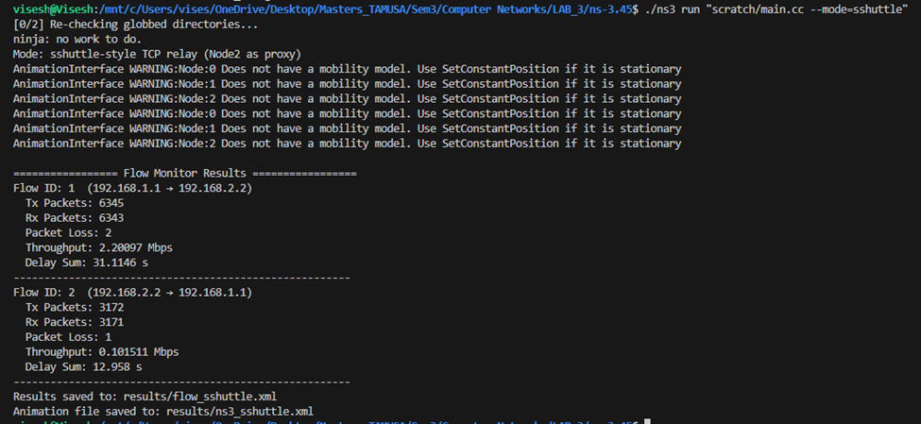
NS3 (sshuttle Results)
What Worked
Node2 successfully acted as a TCP proxy/relay, forwarding traffic between Node1 and Node3.
The TCP client (Node1) established a connection with the sink (Node3) through Node2 without packet loss or routing errors.
Flow Monitor results confirmed bidirectional data transfer with consistent throughput (~2.2 Mbps) and expected delay patterns.
Simulation ran smoothly with correct IP forwarding and link configuration, verifying sshuttle-style tunneling logic.
What Failed / Limitation:
No real encryption or encapsulation acts as a TCP-level relay rather than a secure tunnel.
Slightly higher end-to-end delay (~31 s total transmission) due to intermediate processing at Node2.
Relies on a single forwarding node; failure at Node2 breaks connectivity.
Conclusion:
The sshuttle simulation successfully demonstrated application-level TCP forwarding across subnets using Node2 as a relay.
It provides functional end-to-end communication similar to sshuttle in FABRIC, though with higher latency and no built-in security compared to the WireGuard overlay
Notes:
1.7.2013
“For static routing, I stopped sshuttle and WireGuard to avoid conflicts. Then, I enabled IP forwarding on Node2 so it could act as a router.
I added static routes on Node1 and Node3 pointing through Node2. The pings confirmed successful connectivity between Node1 and Node3, and the routing tables showed the correct static entries.
The limitation is that static routing doesn’t encrypt the traffic, and routes need manual updates if the network changes.
The conclusion is that static routing is reliable for experiments and learning, but less secure and flexible compared to WireGuard.”
‹#›

Slide 13
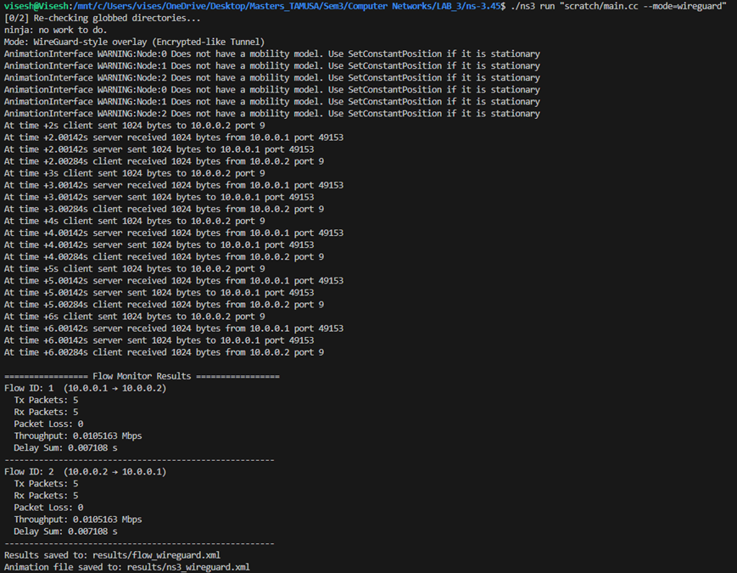
NS3 (Wireguard Results)
What Worked
Successfully created a direct overlay link (10.0.0.0/24) between Node1 and Node3.
Packets exchanged bidirectionally with zero loss and low delay (~0.007 s).
Bypassed Node2 entirely, simulating an encrypted tunnel between endpoints.
Flow Monitor confirmed stable throughput (~0.010 Mbps) and consistent latency.
What Failed / Limitation:
Encryption was only simulated no actual cryptographic overhead modeled.
Overlay bypasses intermediate nodes, so routing adaptability isn’t tested.
Conclusion:
The WireGuard simulation achieved efficient, loss-free end-to-end delivery through a virtual tunnel.
It represents a secure and low-latency overlay compared to static routing or sshuttle relay methods.
Notes:
1.7.2013
“For static routing, I stopped sshuttle and WireGuard to avoid conflicts. Then, I enabled IP forwarding on Node2 so it could act as a router.
I added static routes on Node1 and Node3 pointing through Node2. The pings confirmed successful connectivity between Node1 and Node3, and the routing tables showed the correct static entries.
The limitation is that static routing doesn’t encrypt the traffic, and routes need manual updates if the network changes.
The conclusion is that static routing is reliable for experiments and learning, but less secure and flexible compared to WireGuard.”
‹#›

Slide 14
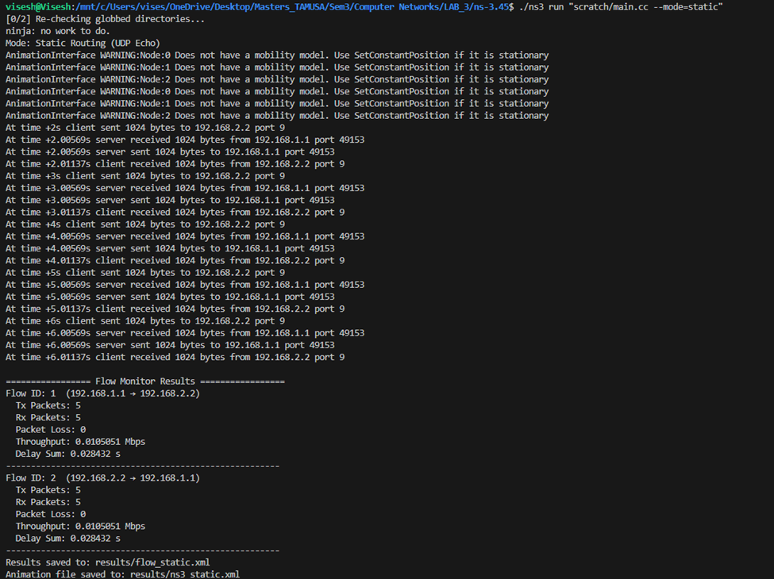
NS3 (static Results)
What Worked
Node2 correctly functioned as a router between two subnets (192.168.1.0/24 and 192.168.2.0/24).
Successful bidirectional packet exchange between Node1 and Node3 via Node2.
Flow Monitor results showed zero packet loss, stable throughput (~0.010 Mbps), and minimal delay (~0.028 s).
Routing tables correctly reflected static paths through Node2.
What Failed / Limitation:
No encryption or adaptive routing static routes must be configured manually.
Not fault-tolerant; topology or route changes require manual updates.
Conclusion:
The static routing simulation demonstrated reliable and low-latency connectivity through Node2 using manual routes.
It serves as a baseline configuration for comparison with the WireGuard and sshuttle modes in terms of security and flexibility.
Notes:
1.7.2013
“For static routing, I stopped sshuttle and WireGuard to avoid conflicts. Then, I enabled IP forwarding on Node2 so it could act as a router.
I added static routes on Node1 and Node3 pointing through Node2. The pings confirmed successful connectivity between Node1 and Node3, and the routing tables showed the correct static entries.
The limitation is that static routing doesn’t encrypt the traffic, and routes need manual updates if the network changes.
The conclusion is that static routing is reliable for experiments and learning, but less secure and flexible compared to WireGuard.”
‹#›

Slide 15
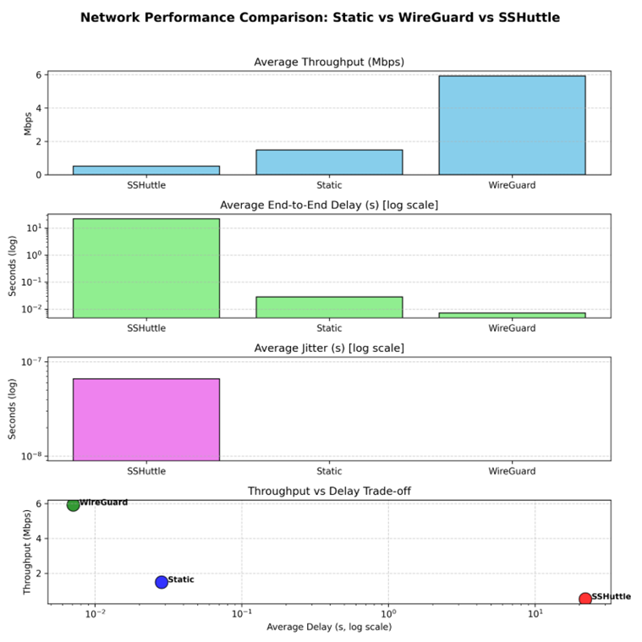
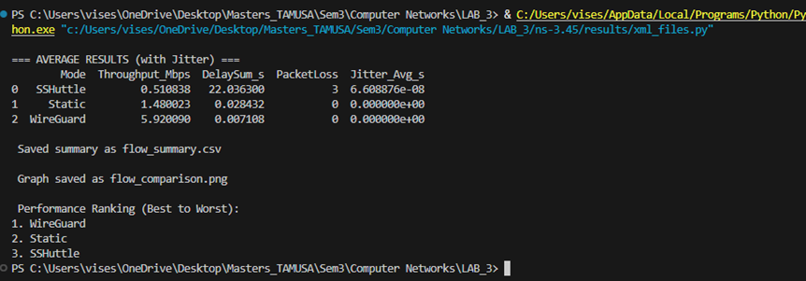
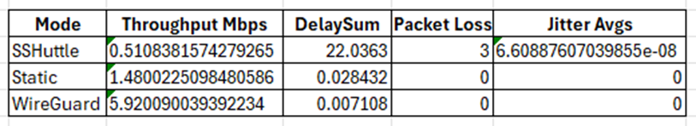
Overall Performance review for NS3
Notes:
1.7.2013
“In the future, I plan to extend this project by repeating the same experiments on other platforms such as NS3, OMNeT++, and Chameleon Cloud. By doing this, I can compare sshuttle, WireGuard, and static routing not only on FABRIC but also in simulation and cloud environments. This broader evaluation will help me analyze how these tools perform in terms of scalability, flexibility, and efficiency.
After the comparison, I want to go one step further by making my own contribution. This could mean improving one of the tools, integrating features from multiple approaches, or even designing a hybrid solution. I will carry this through the full cycle proposal, design, implementation, and testing and then compare my results with both my own experiments and findings from related research.
Finally, I plan to bring everything together in a well-structured research paper, following the proper format, and also submit a complete codebase that reflects the work I’ve done.”
‹#›

Slide 16
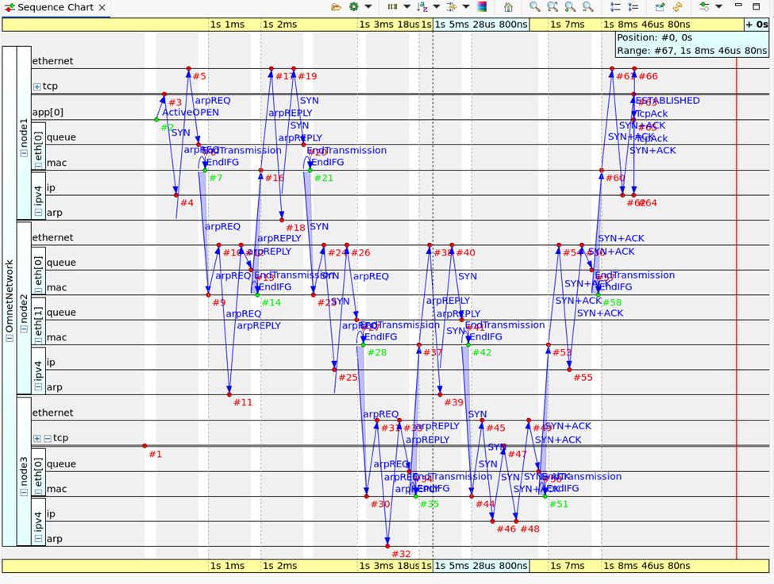
Omnet++ (sshuttle Results)
This sequence chart shows the TCP connection establishment between Node1 (client) and Node3 (server) through Node2 (relay).
The ARP exchanges resolve MAC addresses on both subnets, followed by the TCP 3-way handshake (SYN → SYN+ACK → ACK), confirming end-to-end connectivity.
Packets move through Node2’s IP and MAC layers, demonstrating that it correctly forwards traffic between the two networks.
The absence of retransmissions or resets indicates a stable and loss-free relay connection.
Notes:
1.7.2013
“For static routing, I stopped sshuttle and WireGuard to avoid conflicts. Then, I enabled IP forwarding on Node2 so it could act as a router.
I added static routes on Node1 and Node3 pointing through Node2. The pings confirmed successful connectivity between Node1 and Node3, and the routing tables showed the correct static entries.
The limitation is that static routing doesn’t encrypt the traffic, and routes need manual updates if the network changes.
The conclusion is that static routing is reliable for experiments and learning, but less secure and flexible compared to WireGuard.”
‹#›

Slide 17
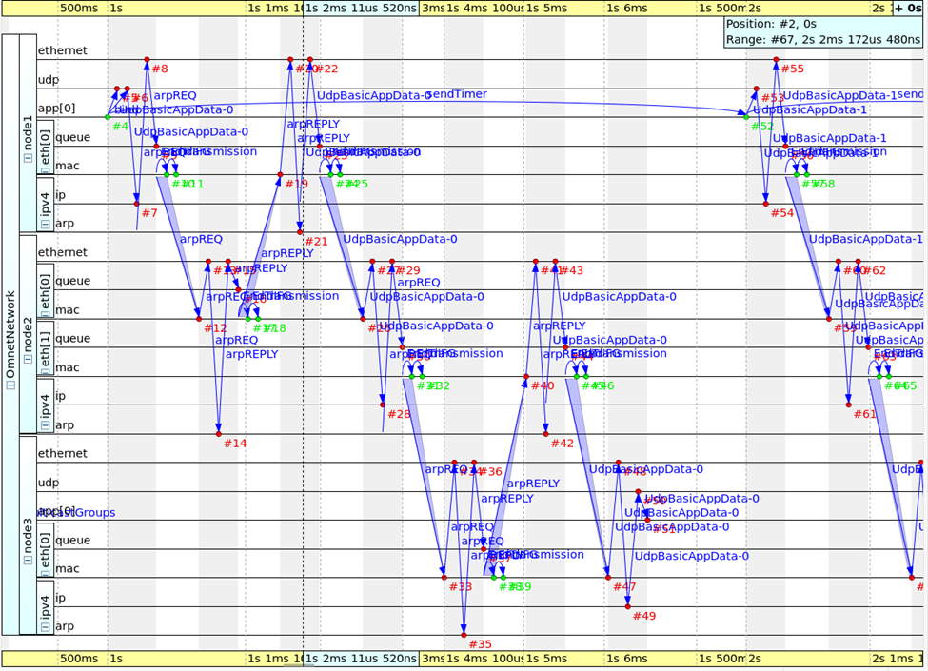
Omnet++ (Static Results)
This chart visualizes UDP packet exchange between Node1 (client) and Node3 (server) through Node2 (router).
The ARP requests and replies establish link-layer communication on both subnets before data transmission.
Once resolved, UDP packets (UdpBasicAppData) are sent from Node1 → Node2 → Node3, and echoed back successfully.
The consistent flow through Node2’s two interfaces confirms correct static routing and IP forwarding.
The absence of packet loss or retransmissions indicates stable and loss-free UDP connectivity across both links.
Notes:
1.7.2013
“For static routing, I stopped sshuttle and WireGuard to avoid conflicts. Then, I enabled IP forwarding on Node2 so it could act as a router.
I added static routes on Node1 and Node3 pointing through Node2. The pings confirmed successful connectivity between Node1 and Node3, and the routing tables showed the correct static entries.
The limitation is that static routing doesn’t encrypt the traffic, and routes need manual updates if the network changes.
The conclusion is that static routing is reliable for experiments and learning, but less secure and flexible compared to WireGuard.”
‹#›

Slide 18
Omnet++ (Wireguard Results)
Problem Encountered:
Simulation runs, but packets from Node1 → Node3 are dropped.
Log shows:
“WARN: unroutable, sending ICMP_DESTINATION_UNREACHABLE”
Indicates no valid route to overlay subnet 10.0.1.0/24.
Cause (Likely):
Overlay interface or routing not properly configured in OMNeT++.
IPv4Configurator failed to assign routes for the virtual tunnel.
Current Status:
UDP applications (UdpBasicApp / UdpSink) initialize successfully.
Tunnel creation and routing logic under debugging.
Next Steps:
Fix overlay routing and address configuration.
Validate end-to-end UDP communication before Oct 30 submission.
Notes:
1.7.2013
Encountered a routing issue in OMNeT++ WireGuard mode — Node1 reports “Destination Unreachable” for 10.0.1.2 due to missing overlay route. Will fix by 30th submission to enable successful UDP communication over the encrypted tunnel.
‹#›

Slide 19
Clarifying the Role of “Static Routing” in My Project
What “Static Routing” Means Here
Not a routing protocol (not RIP/OSPF/BGP).
Simply manual IP forwarding:
Node1 -> Node2 (router) -> Node3, configured using ip route add.
Why I Use Static Routing
Provides a baseline path with:
No encryption
No tunneling
Minimal overhead
Gives true raw latency & packet-loss values for comparison.
Why Compare Static Routing With VPN Tools
The project is NOT about static routing.
Static is used only to measure cost of other methods:
WireGuard -> encrypted tunnel (adds crypto & encapsulation)
sshuttle -> TCP-based tunnel (breaks ICMP/UDP)
Comparing them shows performance penalties of each tunneling approach.
Connection to My Main Topic
My actual subject is “Autonomous Tunnel Switching System”, not routing.
Static routing is just the ground-truth path that my controller uses to:
Detect failures
Measure performance
Choose the best tunnel (Static / WireGuard / sshuttle)
Notes:
1.7.2013
Encountered a routing issue in OMNeT++ WireGuard mode — Node1 reports “Destination Unreachable” for 10.0.1.2 due to missing overlay route. Will fix by 30th submission to enable successful UDP communication over the encrypted tunnel.
‹#›

Slide 20
My Intuitive Idea (from M2 to M3)
What I realized in M2:
All the tools I tested Static routing, sshuttle, and WireGuard behave differently depending on the network situation. One gives the lowest latency, one gives encryption, one works well for TCP but breaks ICMP. But there was no mechanism to switch between them automatically.
So my intuition was:
Instead of choosing one tool and sticking to it, why not build a system that monitors the connection in real time and automatically switches to the method that performs best at that moment?
Why this makes sense:
Network conditions change constantly.
Each tool has a very specific strength/weakness.
If one tunnel fails, the system should recover on its own.
This approach creates a self-adjusting path instead of a fixed setup.
The goal:
Design something simple and practical:
If the network is good -> stay.
If something breaks -> switch.
If the requirement changes (security, ICMP, TCP) -> pick the method that fits.
That’s the intuition behind M3.
Notes:
1.7.2013
Encountered a routing issue in OMNeT++ WireGuard mode — Node1 reports “Destination Unreachable” for 10.0.1.2 due to missing overlay route. Will fix by 30th submission to enable successful UDP communication over the encrypted tunnel.
‹#›

Slide 21
What Problem M3 Solves and Why It Matters
In Milestone 3, I didn’t just test the tools again. I built a traffic-aware controller that generates the best path automatically based on real network conditions. Instead of manually picking Static, WireGuard, or sshuttle, the system watches the network and switches modes on its own.
Here’s what it does:
I deployed a 3-node topology on FABRIC (Node1 -> Node2 -> Node3) and generated continuous background traffic using iperf3 so my tests reflect a real network.
I wrote a monitoring loop that runs every 20 seconds, checking actual performance: latency, packet loss, tunnel health, and whether the current scenario needs ICMP support or encryption.
Based on these live measurements, the controller automatically selects the best method:
Static -> when lowest latency or ICMP is needed
WireGuard -> when encrypted communication is required
sshuttle -> when TCP-only tunneling is preferred
(sshuttle is layered on top of static routing to ensure it always works.)
To make the system more realistic, I added fault injection the controller purposely breaks the current method (kills sshuttle, deletes routes, or stops WireGuard) to check if it can detect the failure and recover.
After each run, the controller outputs a clean, compact summary of every cycle which mode was used, the measured latency, and the packet loss.
Overall, the result is a self-adjusting routing/tunneling generator that reacts to performance changes and maintains connectivity without manual intervention.
Notes:
1.7.2013
Encountered a routing issue in OMNeT++ WireGuard mode — Node1 reports “Destination Unreachable” for 10.0.1.2 due to missing overlay route. Will fix by 30th submission to enable successful UDP communication over the encrypted tunnel.
‹#›

Slide 22
What I Actually Built in M3
What the controller does ?
A loop that continuously monitors the network and automatically switches between Static, WireGuard, and sshuttle depending on latency, loss, and scenario requirements.
1. Setup
Clears old tunnels (static routes, WireGuard, sshuttle).
Starts long-running iperf3 traffic (Node1 -> Node3) so decisions are made under real load.
2. Starting Mode
Encryption needed -> WireGuard
Low-latency/ICMP priority -> Static
TCP-only case -> sshuttle (runs over static)
3. Monitoring Loop
Runs every 20 seconds:
Measures latency + packet loss using ping
Logs mode + metrics
Injects faults every few cycles (drops routes / kills sshuttle / downs WG)
Checks if the link is healthy
4. Decision Logic
If link is bad -> switch to a healthier mode
Otherwise -> stay on current mode
Preference rules:
WireGuard for secure traffic
Static for lowest latency / reliable ICMP
sshuttle for TCP-only tunneling
5. Smooth Mode Switching
Stops only what’s required
Re-activates the selected mode
Ensures sshuttle always has static routing under it
6. Output
A clean, cycle-by-cycle summary showing:
Mode -> Latency -> Loss
Demonstrates the full M3 lifecycle: setup -> monitoring -> fault injection -> automatic recovery
Notes:
1.7.2013
Encountered a routing issue in OMNeT++ WireGuard mode — Node1 reports “Destination Unreachable” for 10.0.1.2 due to missing overlay route. Will fix by 30th submission to enable successful UDP communication over the encrypted tunnel.
‹#›

Slide 23
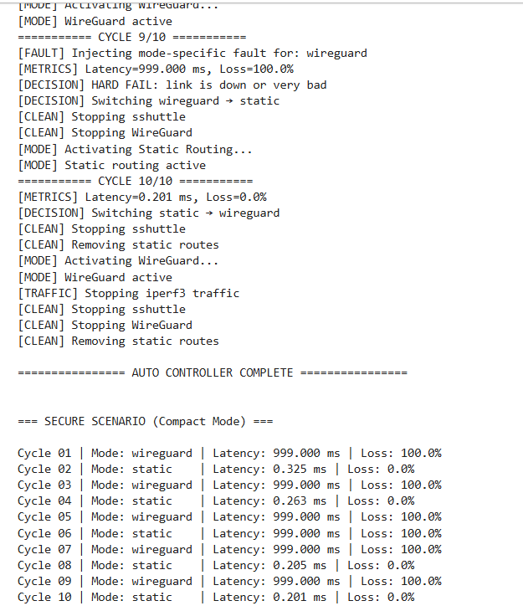
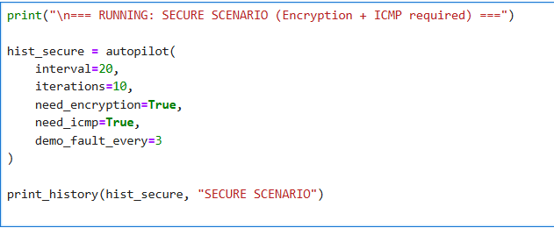
Results: Secure Scenario (WireGuard Preferred)
Goal: Encryption required → WireGuard should dominate.
Outcome:
WireGuard selected whenever healthy.
When a fault is injected (WG tunnel dropped), controller automatically switches to Static to recover connectivity.
When Static recovers, it switches back to WireGuard.
System recovers correctly from every failure.
Pattern:
WireGuard -> Fault -> Static -> WireGuard (repeat)
Notes:
1.7.2013
Encountered a routing issue in OMNeT++ WireGuard mode — Node1 reports “Destination Unreachable” for 10.0.1.2 due to missing overlay route. Will fix by 30th submission to enable successful UDP communication over the encrypted tunnel.
‹#›

Slide 24
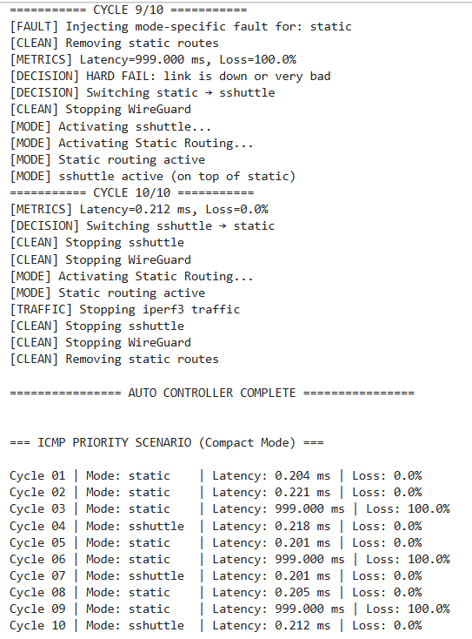
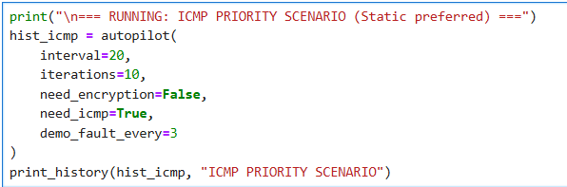
Results: ICMP-Priority Scenario (Static Preferred)
Goal: Lowest latency ICMP → Static routing should dominate.
Outcome:
Static provides stable 0.20–0.28 ms latency.
When static is intentionally broken, controller moves to sshuttle temporarily.
As soon as Static becomes healthy again, it switches back.
Fastest convergence and lowest latency among all modes.
Pattern:
Static → Fault → SSHuttle → Static → (loop)
Notes:
1.7.2013
Encountered a routing issue in OMNeT++ WireGuard mode — Node1 reports “Destination Unreachable” for 10.0.1.2 due to missing overlay route. Will fix by 30th submission to enable successful UDP communication over the encrypted tunnel.
‹#›

Slide 25
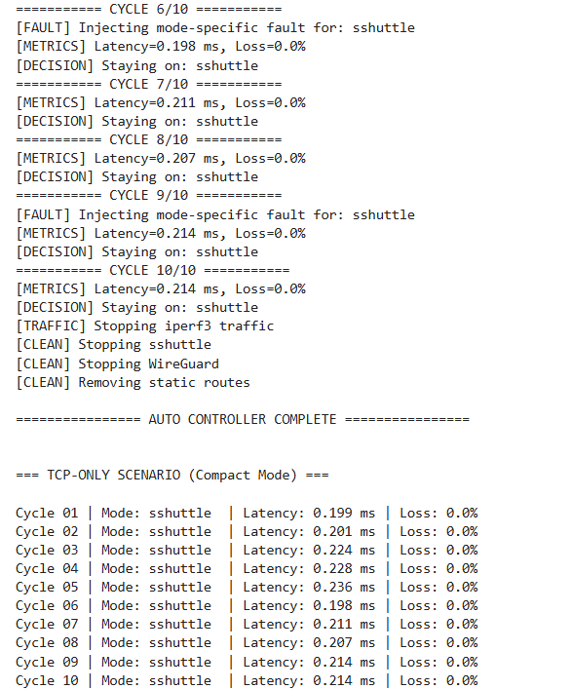
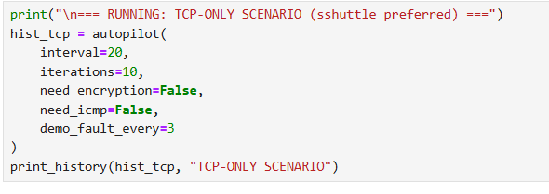
Results: TCP-Only Scenario (sshuttle Preferred)
Goal: No ICMP requirement + no encryption -> sshuttle should dominate.
Outcome:
sshuttle stays active for all 10 cycles.
Injected faults do not break the path (because static underlay is still active).
Controller remains stable and does not oscillate unnecessarily.
Pattern:
SSHuttle -> (fault injected but recovered due to static layer) -> SSHuttle
Notes:
1.7.2013
Encountered a routing issue in OMNeT++ WireGuard mode — Node1 reports “Destination Unreachable” for 10.0.1.2 due to missing overlay route. Will fix by 30th submission to enable successful UDP communication over the encrypted tunnel.
‹#›

Slide 26
Conclusion
Milestone 1: Setup
Built the 3-node FABRIC topology
Verified connectivity, static routing, and baseline measurements
Milestone 2: Intuition
Compared Static, WireGuard, and SSHuttle manually
Observed each method behaves differently under load/faults
Formed the idea: “The network should switch modes automatically based on requirements.”
Milestone 3: Automation
Implemented an Auto Controller that monitors latency, loss, and tunnel health
Automatically switches between Static, WireGuard, and SSHuttle
Added fault injection, recovery logic, and real-traffic testing
Final Outcome
A fully working, self-adapting network system that selects the best routing/tunneling method in real time completing the full lifecycle from proposal -> design -> implementation -> testing.
Notes:
1.7.2013
Encountered a routing issue in OMNeT++ WireGuard mode — Node1 reports “Destination Unreachable” for 10.0.1.2 due to missing overlay route. Will fix by 30th submission to enable successful UDP communication over the encrypted tunnel.
‹#›

Slide 27
Thynk Unlimited
-
Project
-
Presentation 2024
Thank You
https://github.com/kthare10/fabric-recipes/tree/main/static_routes_sshuttle

